Slide 1


Final Project Gr 2
BSCpE22S4 – CPE411
Press the
button to start.

Slide 2

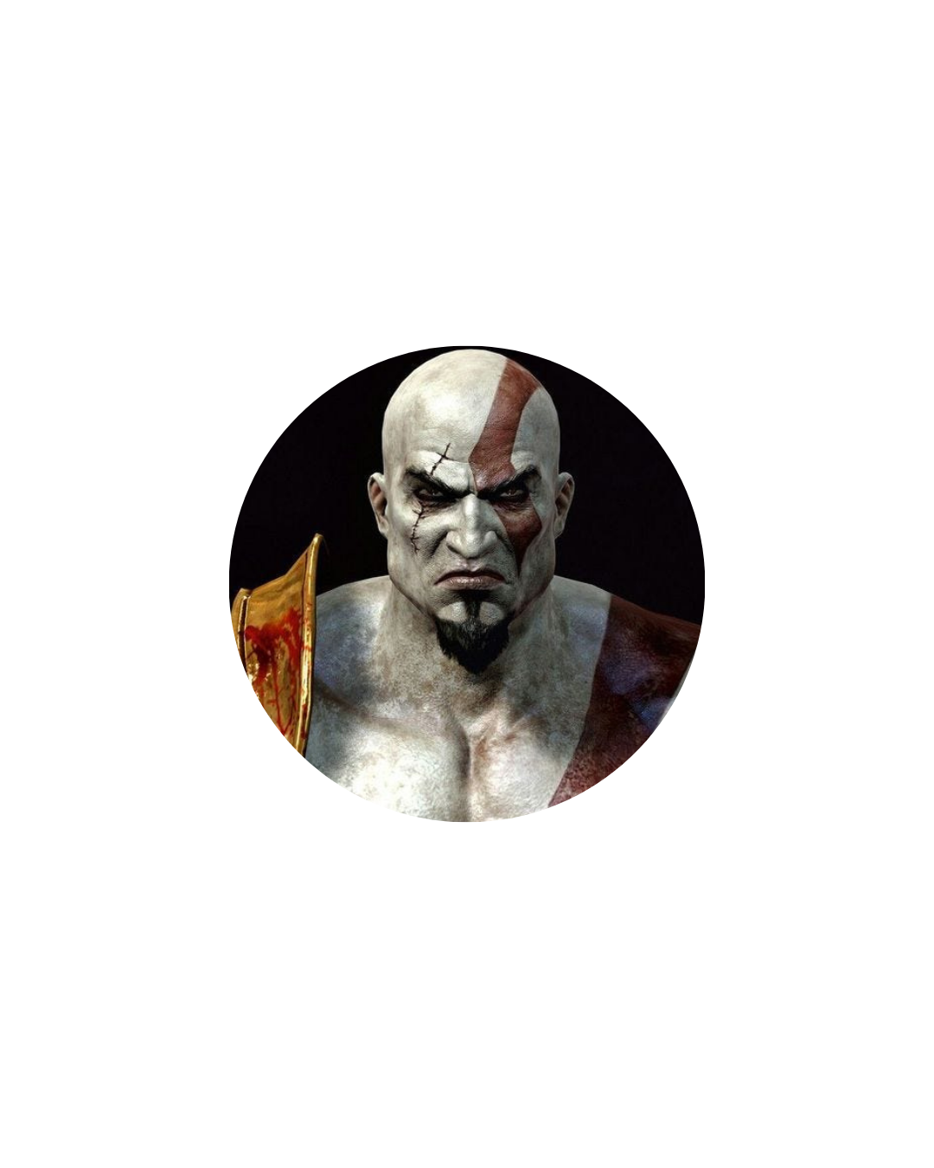



Welcome to our presentation.
Who’s reporting for today?
+
Add User
Bulaong, Ross
Esguerra, Serge
Madriago, Dave
Palomares, Charles

Slide 3

Welcome to our presentation.
Who’s reporting for today?
Bulaong, Ross
Esguerra, Serge
Madriago, Dave
Palomares, Charles
Reyes, Jamie

Slide 4
Welcome to our presentation.
Who’s reporting for today?
Esguerra, Serge
Madriago, Dave
Palomares, Charles
Reyes, Jamie

Slide 5
Welcome to our presentation.
Who’s reporting for today?
Madriago, Dave
Palomares, Charles
Reyes, Jamie

Slide 6
Welcome to our presentation.
Who’s reporting for today?
Palomares, Charles
Reyes, Jamie

Slide 7




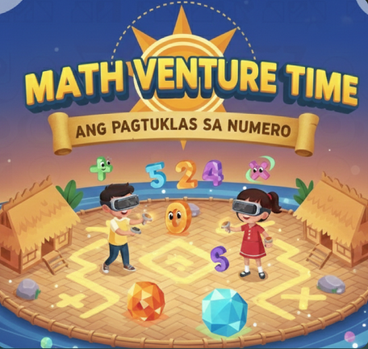


Games
Media
10:45 AM
Playstation Store

Slide 8
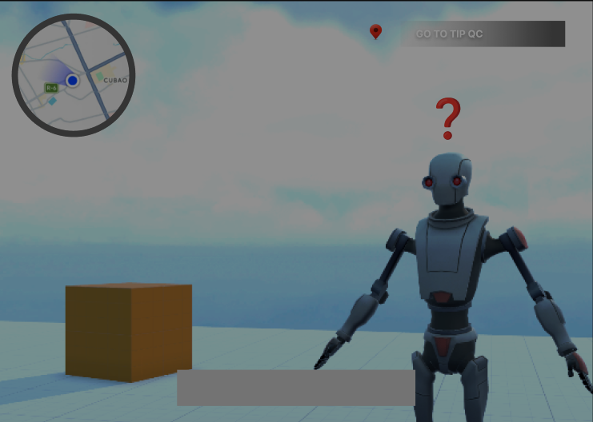

Games
Media
10:45 AM
Word Quest: A VR Quest-Based Game for Improving English-Language Proficiency of 10 Year-old Filipino Children
Details

Slide 9
Problem Statement
Proposed App
10:45 AM
Many Filipino students continue to struggle with foundational English language skills such as reading comprehension and the ability to interpret meaning from text. National and regional assessments show that a large proportion of elementary learners are below minimum proficiency levels — for example, more than half of Filipino Grade 5 students could not understand simple written texts in the latest SEA-PLM cycle, indicating persistent gaps in literacy that affect academic success and higher-order thinking skills such as critical reasoning (Philippine Star, 2025; UNICEF, 2025). Additionally, according to Chi (2024), at least 90% of Filipino children aged 10 struggle to read or even understand simple text.
Low proficiency limits learners’ ability to analyze, interpret, and reason, which are key parts of critical thinking. This highlights the need for innovative and engaging ways to support learning beyond traditional instruction. Efforts in this area align with Sustainable Development Goal 4 (Quality Education), which promotes inclusive and effective learning, and with the Philippine National Research Agenda (PNRA), which emphasizes using technology and evidence-based strategies to improve learning outcomes. Supporting these skills contributes to better literacy, problem-solving, and overall student engagement.
Exit

Slide 10
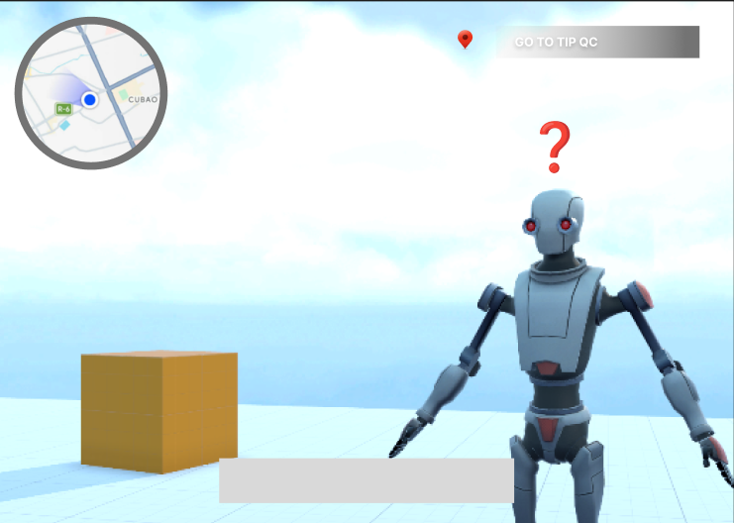
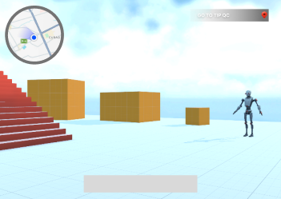
Problem Statement
Proposed App
10:45 AM
Word Quest is a quest-based English learning game designed for 10-year-old Filipino students to improve reading comprehension, vocabulary, and critical thinking. Set in an interactive city, learners complete quests from NPCs that challenge them to understand words in context, solve language puzzles, and apply new vocabulary in practical situations. The app combines quest-based learning, contextual vocabulary practice, critical thinking exercises, and gamified rewards to make language learning engaging and interactive. The game applies HCI principles like consistency (uniform interface), feedback (instant cues), affordance (clear interactive objects), visibility (highlighting key words), and user control (choosing and revisiting quests).
Exit

Slide 11
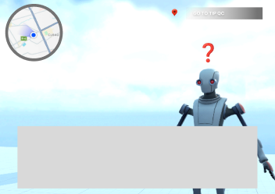
Problem Statement
Proposed App
10:45 AM
Word Quest is a quest-based English learning game designed for 10-year-old Filipino students to improve reading comprehension, vocabulary, and critical thinking. Set in an interactive city, learners complete quests from NPCs that challenge them to understand words in context, solve language puzzles, and apply new vocabulary in practical situations. The app combines quest-based learning, contextual vocabulary practice, critical thinking exercises, and gamified rewards to make language learning engaging and interactive. The game applies HCI principles like consistency (uniform interface), feedback (instant cues), affordance (clear interactive objects), visibility (highlighting key words), and user control (choosing and revisiting quests).
Exit

Slide 12
Problem Statement
Proposed App
10:45 AM
Word Quest is a quest-based English learning game designed for 10-year-old Filipino students to improve reading comprehension, vocabulary, and critical thinking. Set in an interactive city, learners complete quests from NPCs that challenge them to understand words in context, solve language puzzles, and apply new vocabulary in practical situations. The app combines quest-based learning, contextual vocabulary practice, critical thinking exercises, and gamified rewards to make language learning engaging and interactive. The game applies HCI principles like consistency (uniform interface), feedback (instant cues), affordance (clear interactive objects), visibility (highlighting key words), and user control (choosing and revisiting quests).
Exit

Slide 13
Games
Media
10:45 AM
Word Quest: A VR Quest-Based Game for Improving English-Language Proficiency of 10 Year-old Filipino Children
Details

Slide 14
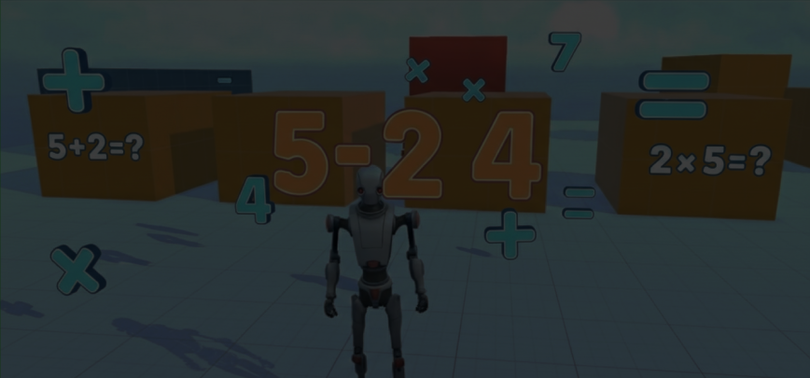
Games
Media
10:45 AM
Mathventure Time: Ang Pagtuklas Sa Numero (A VR Based Math Game for Improving 2nd Grade Elementary Student Arithmetic Proficiency)
Details

Slide 15
Problem Statement
Proposed App
10:45 AM
Many Filipino 2nd-grade students struggle with basic arithmetic, such as addition, subtraction, and number sense, which affects their overall math proficiency and confidence in learning. National and regional assessments, such as the SEA‑PLM 2019 and 2024 reports, show that a significant number of elementary learners are below minimum proficiency levels, with many unable to perform simple calculations accurately or apply math concepts in real-life situations (Philippine Star, 2024; UNICEF Philippines, 2019, 2024). This issue aligns with Sustainable Development Goal 4 (Quality Education), which promotes equitable and effective learning, and with the Philippine National Research Agenda (PNRA), which emphasizes using innovative teaching strategies and technology to improve learning outcomes.
Exit

Slide 16
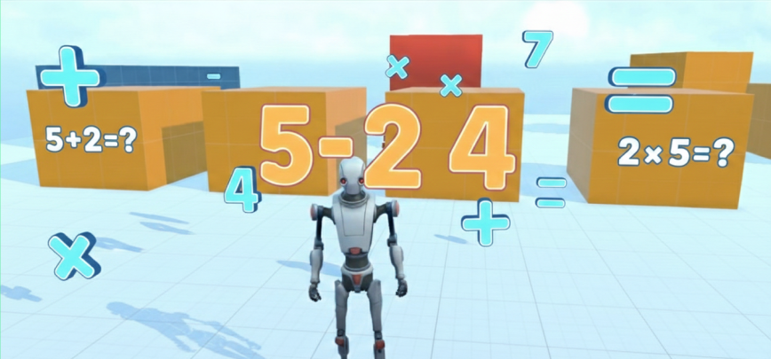
Problem Statement
Proposed App
10:45 AM
Mathventure Time: Ang Pagtuklas Sa Numero is a VR-based math game designed to improve arithmetic skills among 2nd-grade Filipino students. Learners explore an interactive virtual world and complete challenges involving addition, subtraction, and number sense in fun, contextual scenarios. The game incorporates HCI principles such as consistency (uniform interaction patterns across challenges), feedback (instant visual and audio responses for correct or incorrect answers), affordance (interactive objects and tools that clearly indicate how to use them), visibility (highlighting key numbers or problem elements), and user control (allowing learners to navigate and explore at their own pace).
Exit

Slide 17
Games
Media
10:45 AM
Mathventure Time: Ang Pagtuklas Sa Numero (A VR Based Math Game for Improving 2nd Grade Elementary Student Arithmetic Proficiency)
Details

Slide 18
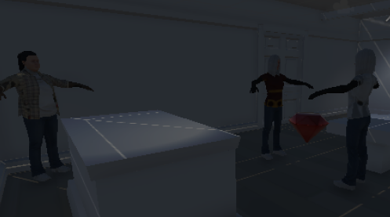
Games
Media
10:45 AM
Between The Lines: A VR Based Detective Game for Enhancing Primary School Students’ Critical Thinking Skills
Details

Slide 19
Problem Statement
Proposed App
10:45 AM
Many Filipino 10-year-old students struggle with critical thinking, which limits their ability to analyze information, interpret clues, and solve problems effectively. National studies show that learners often cannot apply reasoning skills in academic and everyday contexts, highlighting a gap in higher-order thinking development (Philippine Star, 2024; UNICEF, 2025). This challenge aligns with Sustainable Development Goal 4 (Quality Education), which promotes inclusive and effective learning, and with the Philippine National Research Agenda (PNRA), which emphasizes developing cognitive skills and problem-solving abilities through innovative, technology-based educational strategies.
Exit

Slide 20
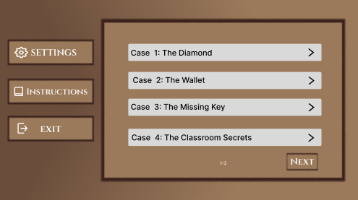
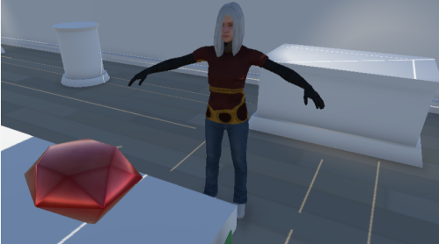
Problem Statement
Proposed App
10:45 AM
Between the Lines is a quest-based detective game designed to enhance critical thinking in 10-year-old Filipino learners. Players explore a virtual levels, solve puzzles, and interpret clues either mentioned “between the lines” of dialogue or via clues hidden within the level to complete challenges, training them to analyze, reason, and make informed decisions.
Exit

Slide 21
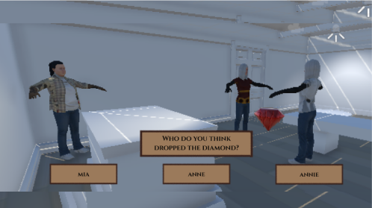
Problem Statement
Proposed App
10:45 AM
Between the Lines is a quest-based detective game designed to enhance critical thinking in 10-year-old Filipino learners. Players explore a virtual levels, solve puzzles, and interpret clues either mentioned “between the lines” of dialogue or via clues hidden within the level to complete challenges, training them to analyze, reason, and make informed decisions.
Exit

Slide 22
Problem Statement
Proposed App
10:45 AM
Between the Lines is a quest-based detective game designed to enhance critical thinking in 10-year-old Filipino learners. Players explore a virtual levels, solve puzzles, and interpret clues either mentioned “between the lines” of dialogue or via clues hidden within the level to complete challenges, training them to analyze, reason, and make informed decisions. The game incorporates HCI principles such as consistency (uniform design and controls across levels), feedback (immediate visual and audio responses for actions), affordance (intuitive objects and interactive elements), visibility (clear presentation of important clues), and user control (allowing learners to explore at their own pace)
Exit

Slide 23
References
10:45 AM
Philippine Star. (2024, January 11). Explainer: With students’ poor literacy, are all teachers now “reading teachers”? https://www.philstar.com/headlines/2024/01/11/2325063/explainer-students-poor-literacy-are-all-teachers-now-reading-teachers
Philippine Star. (2025, December 17). New study: 7 in 10 students in the Philippines lack basic reading skills. https://www.philstar.com/headlines/2025/12/17/2494945/new-study-7-10-students-philippines-lack-basic-reading-skills/
UNICEF Philippines. (2024). SEA‑PLM 2024 learning outcomes: Mathematics and reading proficiency results for the Philippines. https://www.mexc.co/news/250036
UNICEF. (2025). Latest SEA‑PLM 2024 reveals more learners in the Philippines reaching higher proficiency in math and reading, but disparities remain. https://www.unicef.org/philippines/press-releases/latest-sea-plm-2024-reveals-more-learners-philippines-reaching-higher-proficiency
Exit

